Slide 1
Lecture 8
Data Warehousing and Data Mining

Slide 2
A producer wants to know….
Which are our
lowest/highest margin
customers ?
Who are my customers
and what products
are they buying?
What is the most
effective distribution
channel?
What product prom-
-otions have the biggest
impact on revenue?
Which customers
are most likely to go
to the competition ?
What impact will
new products/services
have on revenue
and margins?

Slide 3
Data, Data everywhere yet ...
I can’t find the data I need
  Data is scattered over the network
  Many versions, subtle differences
I can’t get the data I need
  need an expert to get the data
I can’t understand the data I found
  available data poorly documented
I can’t use the data I found
  results are unexpected
  data needs to be transformed from one form to other

Slide 4

What is a Data Warehouse?
    “A data warehouse is a subject-oriented, integrated, time-variant and non-volatile collection of data in support of management's decision-making process.”
    Data Warehousing: Process of constructing (and using) a data warehouse

Slide 5
Data Warehouse
    Subject-oriented:
      Focused on important subjects, not transactions
      Concise view with only useful data for decision making
    Integrated:
      Constructed from multiple, heterogeneous data sources. Normally distributed relational databases.

Slide 6
Data Warehouse
    Time-variant:
      Has different values for the same fields over time.
      Operational database only has current value. Data Warehouse offers historical values.
    Nonvolatile:
      Updates not online, but in offline batch mode only
      Read only access required, so no concurrency issues

Slide 7
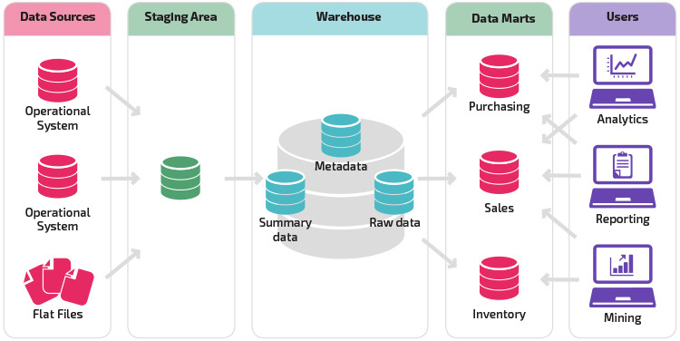
Data Warehouse Architecture

Slide 8
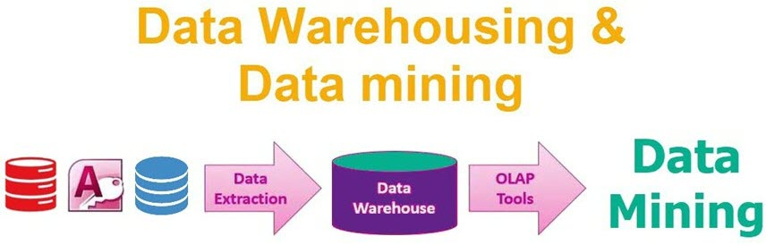

Slide 9
OLTP vs OLAP
  OLTP: Online Transaction Processing (Operational DBMS)
  Present data
  EG: ATM systems‏
  OLAP: Online Analytical Processing (Data Warehouse)‏
  Historical data

Slide 10
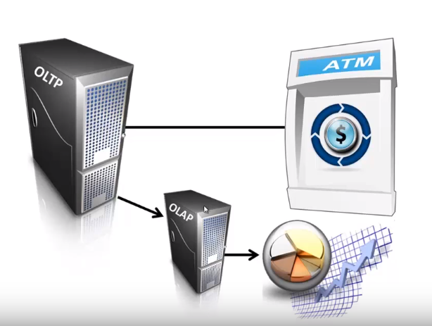

Slide 11
Comparison of OLTP and
Data Warehousing(OLAP)
OLTP (Database systems) Data warehousing systems (OLAP)
Holds current data Holds historic data
Stores detailed data Stores detailed, lightly, and summarized data
Data is dynamic Data is largely static
Repetitive processing Ad hoc, unstructured, and heuristic processing
High level of transaction throughput Medium to low transaction throughput
Predictable pattern of usage Unpredictable pattern of usage
Transaction driven Analysis driven
Application oriented Subject oriented
Supports day-to-day decisions Supports strategic decisions
Serves large number of Serves relatively lower number
clerical / operational users of managerial users

Slide 12
OLTP vs Data Warehouse
OLTP (database)
  Performance Sensitive
  Few Records accessed at a time (tens)
  Read/Update Access
  No data redundancy
  Database Size 100MB -100 GB
Data Warehouse
  Performance relaxed
  Large volumes accessed at a time(millions)
  Mostly Read (Batch Update)
  Redundancy present
  Database Size 100 GB - few terabytes

Slide 13

To summarize ...
OLTP Systems are
used to “run” a business
The Data Warehouse helps to “optimize” the business

Slide 14
OLAP Tools
Short for Online Analytical Processing, a category of software tools that provides analysis of data stored in a database.
OLAP tools enable users to analyze different dimensions of multidimensional data.
  For example, it provides time series and trend analysis views.
Multi-dimensional OLAP (MOLAP)
Relational OLAP (ROLAP)
  Creation of multiple multi-dimensional views of the two-dimensional relations
Hybrid OLAP (HOLAP)
  HOLAP technologies attempt to combine the advantages of MOLAP and ROLAP

Slide 15
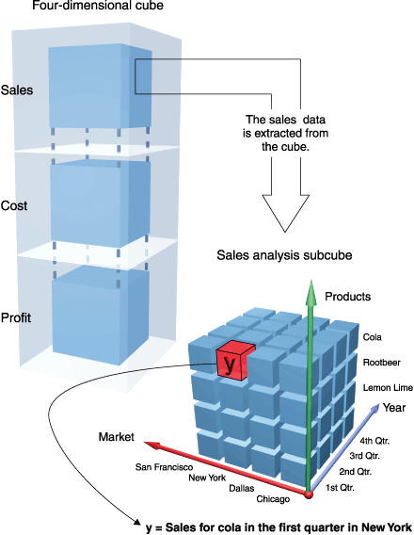
Data Cubes
  Data is normally Multi-Dimensional, and can be thought of as a cube.
  Often: 3 dimensions of time, location and product.

Slide 16
Data Cube Operations
  Roll Up: Summarise data by climbing up hierarchy.
  Eg. From monthly to quarterly, from Liverpool to England
  Drill Down: Opposite of Roll Up
  Eg. From computer to laptop
  Slice: Remove a dimension by setting a value for it
  Eg. location/product where time is Q1,2007
  Dice: Restrict cube by setting values for multiple dimensions
  Eg. Q1,Q2 / North American cities / 3 products sub cube
  Pivot: Rotate the cube (mostly for visualisation)

Slide 17
Data Mining Definition
Finding hidden information in a database
Similar terms
  Exploratory data analysis
  Data driven discovery
  Deductive learning
Information
Data

Slide 18
Query Examples
Database
Data Mining
Find all credit applicants with last name of Smith.
  Identify customers who have purchased more than $10,000 in the last month.
        Find all customers who have purchased milk
  Find all credit applicants who are poor credit risks. (classification)
        Identify customers with similar buying habits. (Clustering)
        Find all items which are frequently purchased with milk. (association rules)

Slide 19
Related Fields
Machine
Learning
Visualization
Data Mining and
Knowledge Discovery
Statistics
Databases

Slide 20
What is data mining?
A class of database application that analyze data in a database using tools which look for trends or anomalies.
Data mining was invented by IBM.
Data mining is the exploration and analysis of large quantities of data in order to discover valid, novel, potentially useful, and ultimately understandable patterns in data.
Valid: The patterns hold in general.
Novel: We did not know the pattern beforehand.
Useful: We can devise actions from the patterns.
Understandable: We can interpret the patterns and correlations.

Slide 21
What is Data Mining?
Examples of tasks addressed by Data Mining
  Predictive Modeling (classification)
  Segmentation (Data Clustering )
  Summarization
  Visualization
Ex: Data mining software can help retail companies find customers with common interests.

Slide 22
Data Mining
Data Mining is a step of Knowledge Discovery in Databases (KDD) Process, which includes:
  Data Warehousing
  Data Selection
  Data Preprocessing
  Data Transformation
  Data Mining
  Interpretation/Evaluation
Data Mining is sometimes referred to as KDD and DM and KDD tend to be used as synonyms

Slide 23
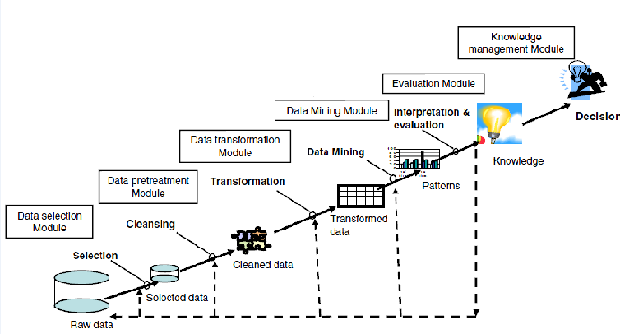

Slide 24
Data Mining is Not …
Data warehousing
SQL / Ad Hoc Queries / Reporting
Software Agents
Online Analytical Processing (OLAP)
Data Visualization

Slide 25
Major Application Areas for
Data Mining Solutions
Advertising
Bioinformatics
Customer Relationship Management (CRM)
Database Marketing
Fraud Detection
E-Commerce
Health Care
Investment/Securities
Manufacturing, Process Control
Sports and Entertainment
Telecommunications
Web

Slide 26
The Need for Data Mining
The amount of raw data stored in corporate data warehouses is growing rapidly.
There is too much data and complexity that might be relevant to a specific problem.
Data mining promises to bridge the analytical gap by giving knowledge workers the tools to navigate this complex analytical space.
The need for information has resulted in the proliferation of data warehouses that integrate information multiple sources to support decision making.

Slide 27
Sutna pugyo?
Aba uthne Attendance hudai xa!

Slide 28
Data Mining Step in Detail
2.1 Data preprocessing
  Data selection: Identify target datasets and relevant fields
  Data cleaning
    Remove noise and outliers
    Data transformation
    Create common units
    Generate new fields
2.2 Data mining model construction
2.3 Model evaluation

Slide 29
Preprocessing and Mining
Knowledge
Patterns
Preprocessed
Data
Target
Data
Interpretation
Model
Construction
Original Data
Preprocessing
Data
Integration
and Selection

Slide 30
Data Mining Techniques
Data Mining Techniques
Descriptive
Clustering
Association
Sequential Analysis
Predictive
Classification
Decision Tree
Rule Induction
Neural Networks
Nearest Neighbor Classification
Regression

Slide 31
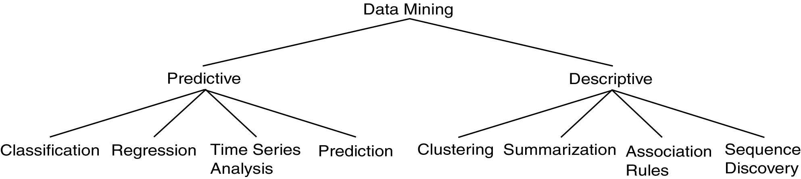
Data Mining Models and Tasks

Slide 32
Basic Data Mining Tasks
Classification maps data into predefined groups or classes
  Supervised learning
  Pattern recognition
  Prediction
Regression is used to map a data item to a real valued prediction variable.
Clustering groups similar data together into clusters.
  Unsupervised learning
  Segmentation
  Partitioning

Slide 33
Basic Data Mining Tasks (cont’d)
Summarization maps data into subsets with associated simple descriptions.
  Characterization
  Generalization
Link Analysis uncovers relationships among data.
  Affinity Analysis
  Association Rules
  Sequential Analysis determines sequential patterns.

Slide 34
Ex: Time Series Analysis
Example: Stock Market
Predict future values
Determine similar patterns over time
Classify behavior

Slide 35
Data Mining vs. KDD
Knowledge Discovery in Databases (KDD): process of finding useful information and patterns in data.
Data Mining: Use of algorithms to extract the information and patterns derived by the KDD process.

Slide 36
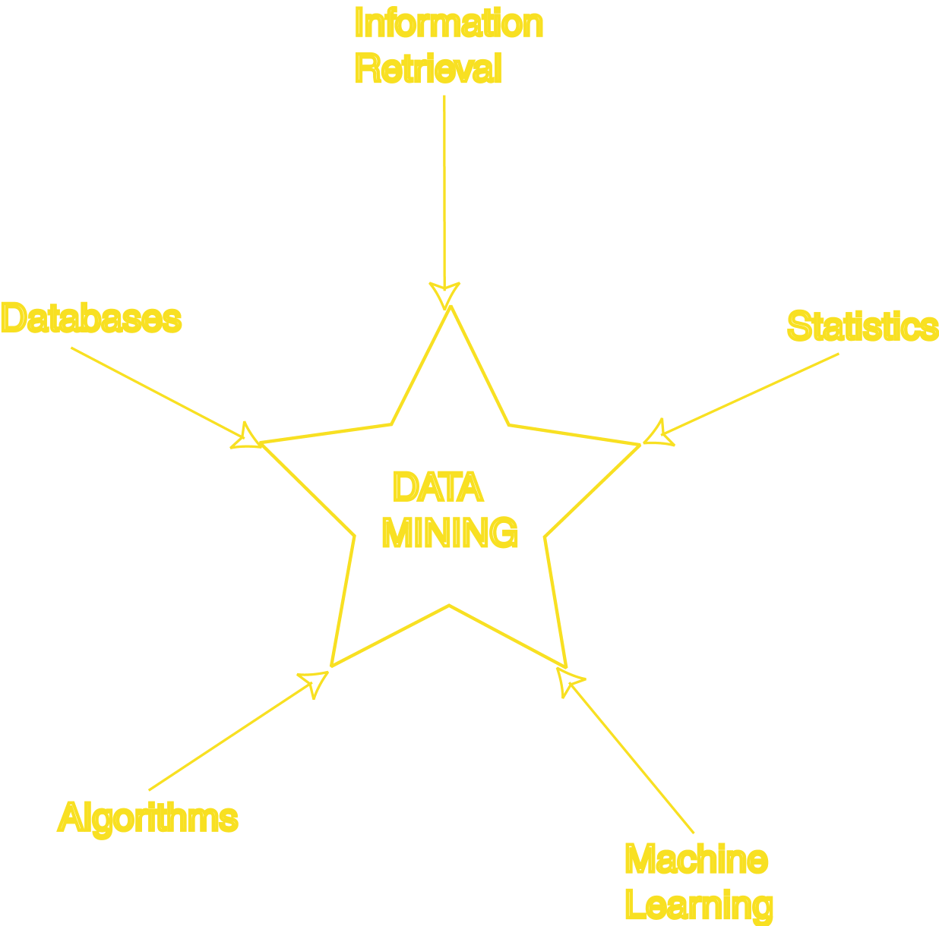
Data Mining Development
Similarity Measures
Hierarchical Clustering
IR Systems
Imprecise Queries
Textual Data
Web Search Engines
Relational Data Model
SQL
Association Rule Algorithms
Data Warehousing
Scalability Techniques
Bayes Theorem
Regression Analysis
EM Algorithm
K-Means Clustering
Time Series Analysis
Algorithm Design Techniques
Algorithm Analysis
Data Structures
Neural Networks
Decision Tree Algorithms

Slide 37
KDD Issues
Human Interaction
Overfitting
Outliers
Interpretation
Visualization
Large Datasets
High Dimensionality

Slide 38
KDD Issues (cont’d)
Multimedia Data
Missing Data
Irrelevant Data
Noisy Data
Changing Data
Integration
Application

Slide 39
Data Mining Applications: Retail
Performing basket analysis
  Which items customers tend to purchase together. This knowledge can improve stocking, store layout strategies, and promotions.
Sales forecasting
  Examining time-based patterns helps retailers make stocking decisions. If a customer purchases an item today, when are they likely to purchase a complementary item?
Database marketing
  Retailers can develop profiles of customers with certain behaviors, for example, those who purchase designer labels clothing or those who attend sales. This information can be used to focus cost–effective promotions.
Merchandise planning and allocation
  When retailers add new stores, they can improve merchandise planning and allocation by examining patterns in stores with similar demographic characteristics. Retailers can also use data mining to determine the ideal layout for a specific store.

Slide 40
Data Mining Applications: Banking
Card marketing
  By identifying customer segments, card issuers and acquirers can improve profitability with more effective acquisition and retention programs, targeted product development, and customized pricing.
Cardholder pricing and profitability
  Card issuers can take advantage of data mining technology to price their products so as to maximize profit and minimize loss of customers. Includes risk-based pricing.
Fraud detection
  Fraud is enormously costly. By analyzing past transactions that were later determined to be fraudulent, banks can identify patterns.
Predictive life-cycle management
  DM helps banks predict each customer’s lifetime value and to service each segment appropriately (for example, offering special deals and discounts).

Slide 41
Data Mining Applications: Telecommunication
Call detail record analysis
  Telecommunication companies accumulate detailed call records. By identifying customer segments with similar use patterns, the companies can develop attractive pricing and feature promotions.
Customer loyalty
  Some customers repeatedly switch providers, or “churn”, to take advantage of attractive incentives by competing companies. The companies can use DM to identify the characteristics of customers who are likely to remain loyal once they switch, thus enabling the companies to target their spending on customers who will produce the most profit.

Slide 42
Data Mining Applications: Other Applications
Customer segmentation
  All industries can take advantage of DM to discover discrete segments in their customer bases by considering additional variables beyond traditional analysis.
Manufacturing
  Through choice boards, manufacturers are beginning to customize products for customers; therefore they must be able to predict which features should be bundled to meet customer demand.
Warranties
  Manufacturers need to predict the number of customers who will submit warranty claims and the average cost of those claims.
Frequent flier incentives
  Airlines can identify groups of customers that can be given incentives to fly more.

Slide 43
Aba sutey hunxa,
Slides Sakiyo!

